Slide 1
INTRODUCTION TO THEORETICAL COMPUTER SCIENCE
CSC 304
Professor Lucci
Lecture 2

Slide 2
Recap Keywords from Lesson 1
Algorithm
Procedure
Algorithm primitives
High Level Language (HLL)
Compiler
Source Program
Object Code
Computer
Solvable/ Problem
Decision Problem
Decidable/Undecidable Problem
Tractable/ Intractable Problem
Polynomial, super-polynomial, exponential, factorial time
Abstract Model of Computation
Mathematical Model of Computation
Reasonable Model of Computation
ALU, CU, SISD
Stored program concept
Turning machine
State
Unary Notation
Unbounded

Slide 3
We have considered the Turing machine as a reasonable model of computation.
Other models considered in this course:
Finite state machine
Pushdown automaton

Slide 4
Automata Models
Finite state machine
Pushdown automaton
Turing machine

Slide 5
Definition
Automaton – noun (plural- tons, ta):
A mechanical device operating under its own power; a robot
A person who acts mechanically or leads a routine monotonous life.
*from Dictionary.com

Slide 6
Finite State Machine
Chief Characteristic:
it only has a finite amount of memory which is fixed a priori. The memory cannot be augmented (where as with a Turing machine, one can always obtain more memory)

Slide 7
Pushdown Automaton
Has both
An output tape
A stack memory
The stack is unbounded

Slide 8
A Finite State Machine
Input Tape
read head
Program – list of instructions
*Occasionally, you may use a model with an output tape as well upon which answers appear.
Observations:
Head can only read an input tape. Writing is forbidden!
The number of states (in control mechanism) is fixed in advance.
Movement is one way only. The head is always moving to the right (whereas a Turing machine can move left or right)
( | ( | ) | )
⇧
Control

Slide 9
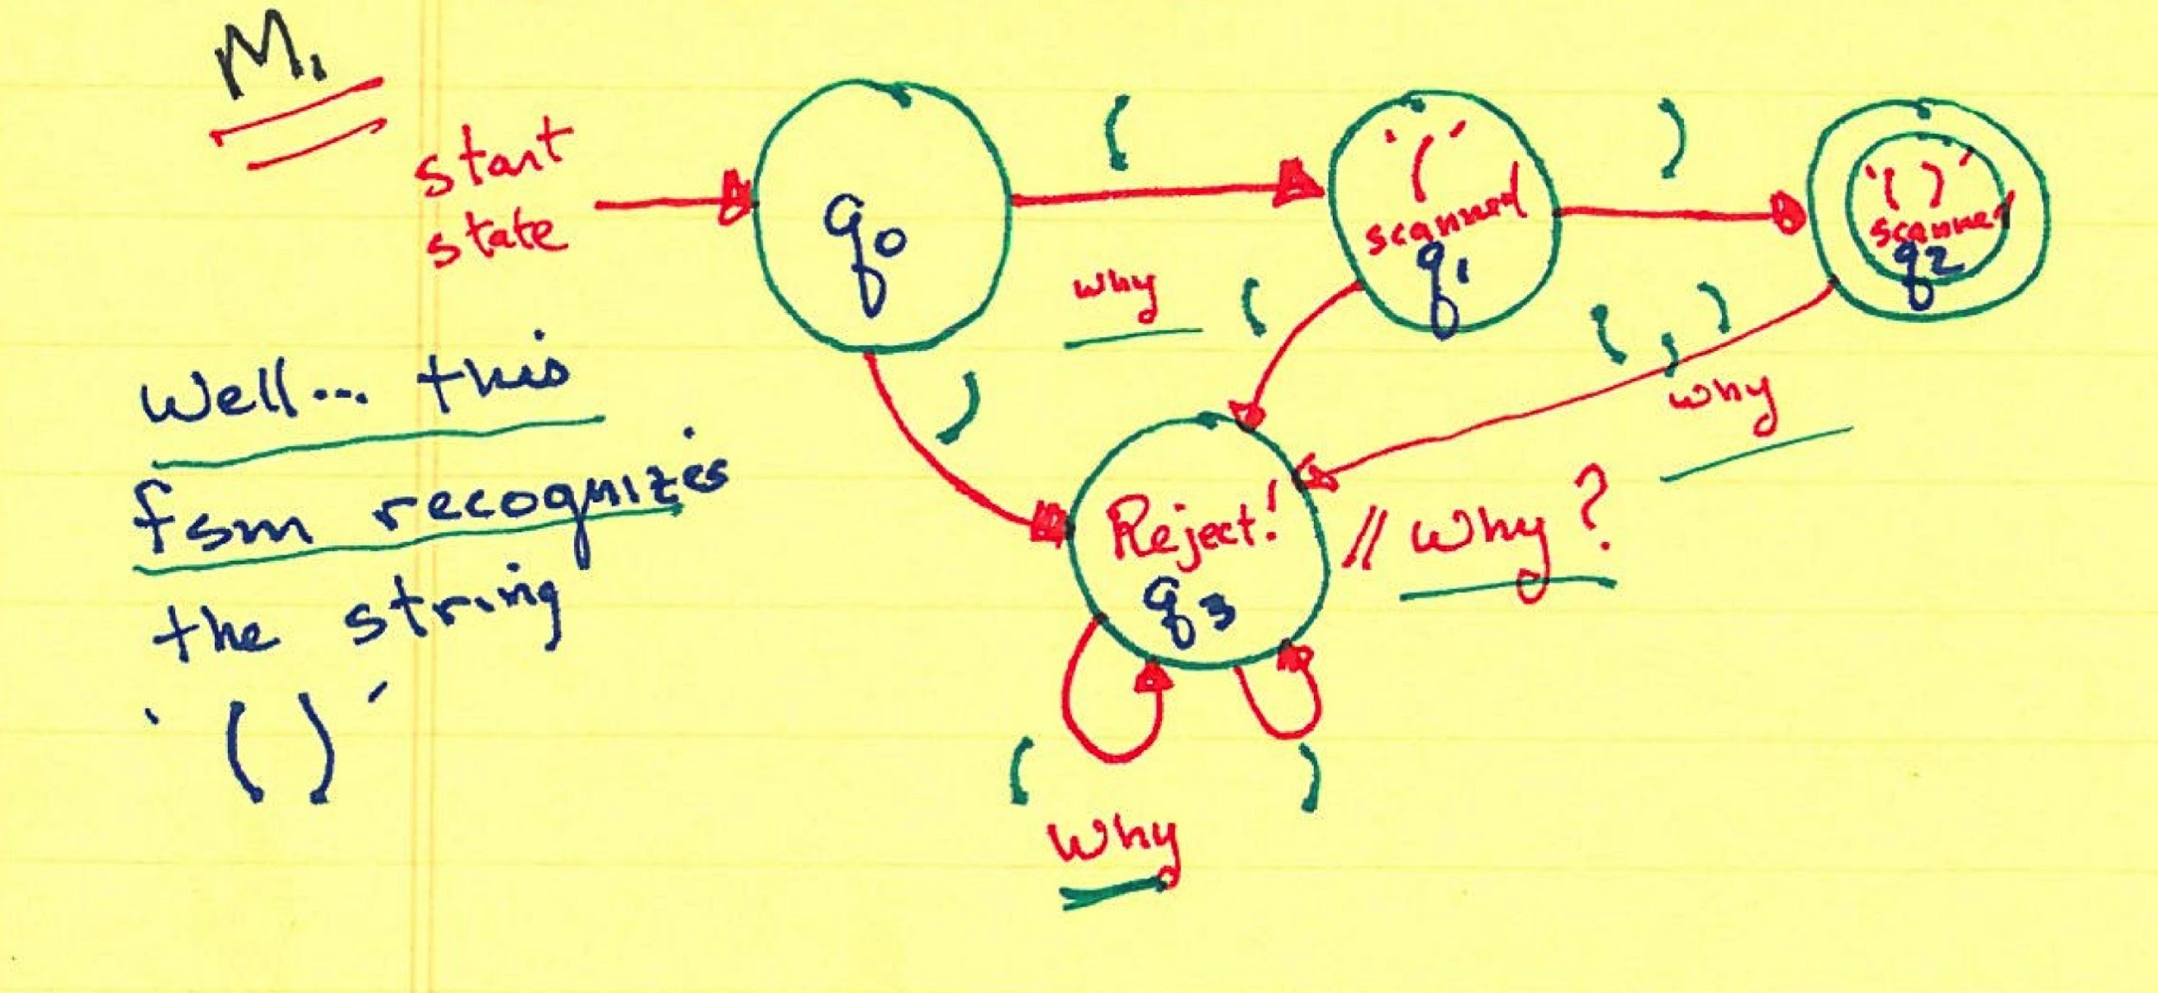
Problem: A FSM to recognize parenthesized expressions.
( ), ( ( ) ), ( ( ( ) ) ) would be accepted but ( (, ( ) ), and ( ) ( ) ) would not be
Accept states denoted by two concentric circles
A FSM may contain more than one accept state.

Slide 10
We have built an FSM to recognize the string ‘( )’ …M₁
Now let’s design an FSM to recognize the set of strings { ( ), ( ( ) )}
M₂:

Slide 11
We observe that M₂ does indeed recognize {( ),( ( ) ) }
However, M₂ fails when presented with ‘( ( ( ) ) )’ or ‘( ( ) ( ) )’
How many states would an FSM require to recognize ‘( ( ( ) ) )’?
The same question generalized to any well balanced parenthesized expression?
This problem is unsolvable on an FSM!

Slide 12
Pushdown Automaton(PDA)
Can the language of well- balanced expressions be recognized on a PDA?

Slide 13
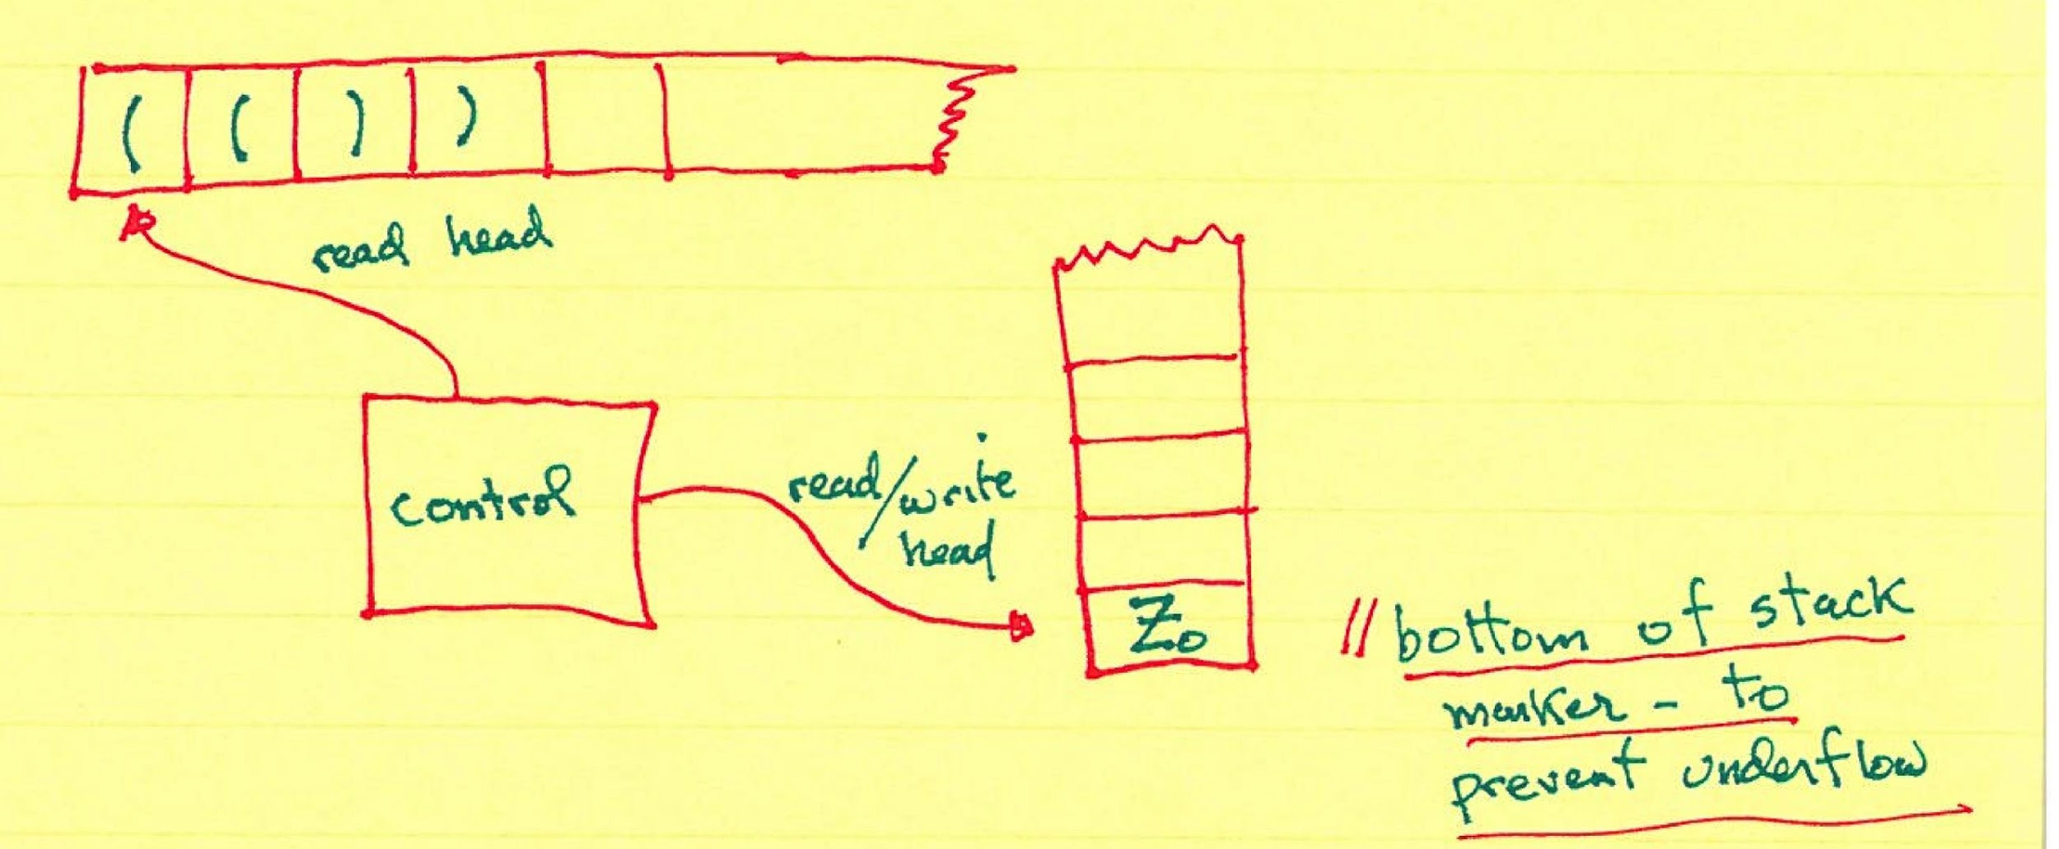
PDA (Push Down Automata)
In one move the PDA
Reads symbol on input tape
Checks its own state
Scans symbol on Stack
And then:
Moves r/w head one square to right
May pop a symbol off the stack
Push one or more symbols onto stack
May change state

Slide 14
A PDA to recognize (a subset for now only) of the language of well balanced parenthesized expressions
i.e. L = { (^{n} )^{n} | n >= 1} – this is called a language expression
A language is merely a set of strings (more on this later)
A language expression is shorthand to help us denote specific languages

Slide 15
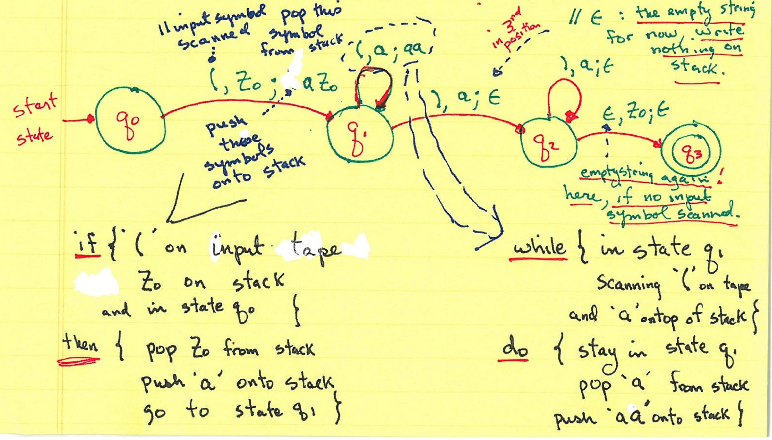

Slide 16
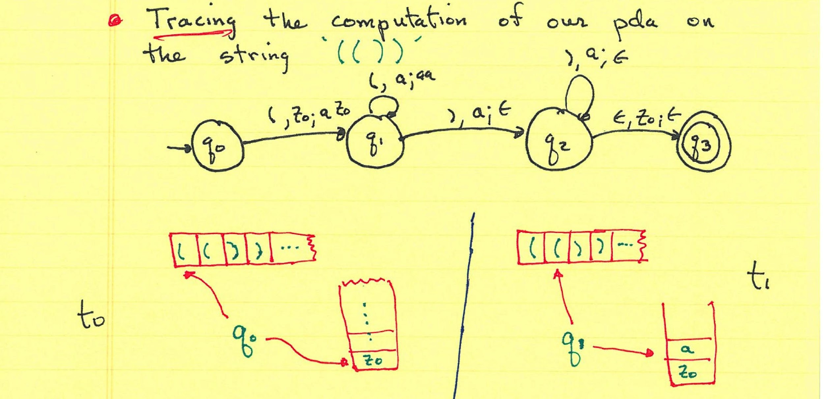

Slide 17
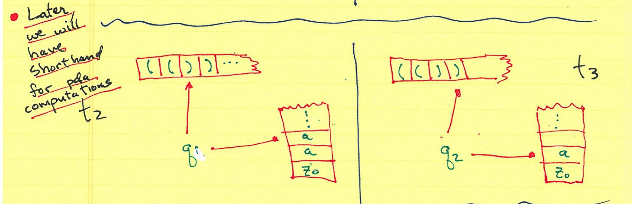

Slide 18
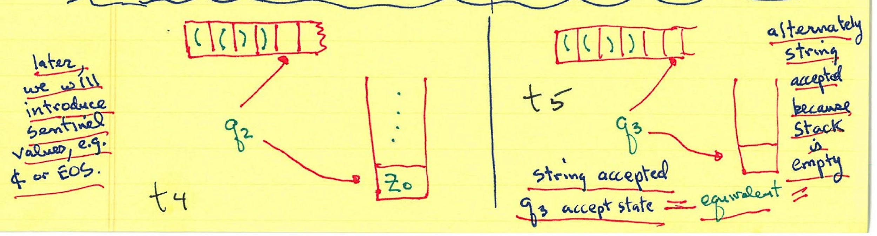

Slide 19
Recognizing the language L = { (^{n} )^{n} | n >= 1} was impossible on an FSM.
However, L is recognizable on a PDA!
Word Processing Task: Type n letters. Backup n spaces. Then underline the string.
Lets try to recognize L = {a^{n}b^{n}c^{n} | n >= 1}
Note: a^{n} is shorthand for n copies of the letter ‘a’

Slide 20
Do we begin by pushing a’s on stack, then pop a’s once b’s are encountered
Next…a ‘c’ is scanned….WHAT NOW?!
OR
Pass a’s until a ‘b’ is encountered and match b’s with c’s
We are stuck!
How many a’s were there?!!

Slide 21
Nobody say count!!!
In this course ‘count’ is a four letter word
Why is counting forbidden?

Slide 22
Turing Machines Revisited
Recognizing L = {a^{n}b^{n}c^{n} | n >= 1} is impossible on a PDA
However, a Tm to recognize L is possible
First we need a strategy:

Slide 23
A Turing machine to recognize L = {a^{n}b^{n}c^{n} | n >= 1}:
What if a problem is not solvable on a Turing machine- Where do we look?!

Slide 24
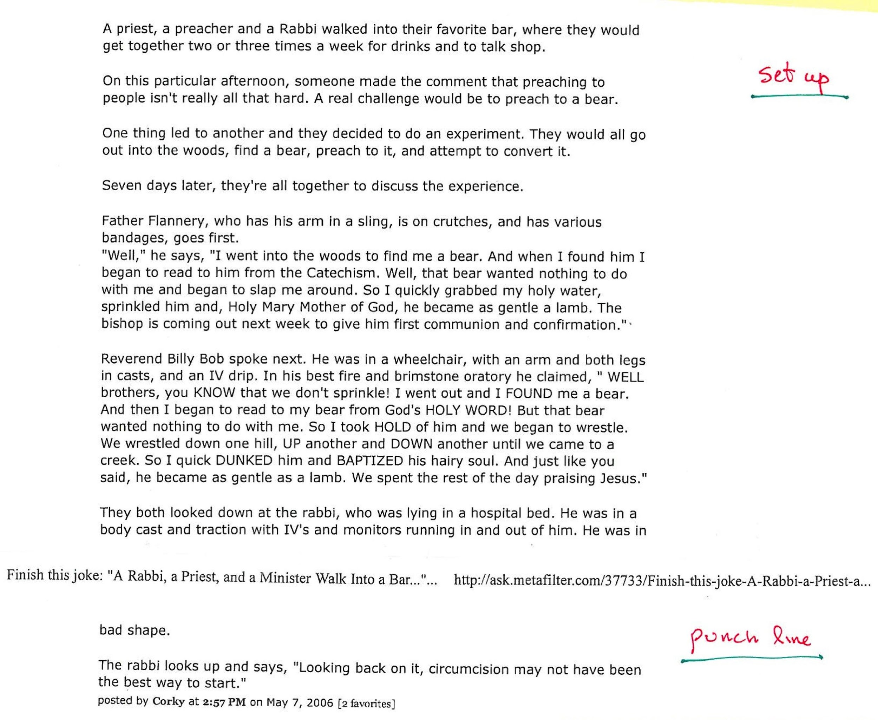
First…a joke

Slide 25
Back to Tm’s
Set Up
The computational power of a PDA is greater than that of a FSM as there are problems unsolvable on an FSM that can be solved on a PDA
Similarly, a Tm has greater computational power than a PDA

Slide 26
Turing-Church Thesis
The computational power of a digital computer is equivalent to that of a Turing machine

Slide 27
Punch Line:
If a problem can be shown to be unsolvable on a Turing machine then the problem is unsolvable on a digital computer
Most computer scientists believe the Turing-Church thesis
*** Remember this is a thesis not a theorem.
Ex: Does God exist?!

